Slide 1
ESFP 2 PROJECT HOTEL MANAGEMENT SYSTEM
Presented By
Raval Mihir
20162101017

Slide 2
Database
The database for hotel management is for 2 customers.
It includes the customer name, customer id, check in date, check out date, customer location , room type, contact no ,breakfast service ,guide needed.

Slide 3
LIBRARIES USED
The libraries which are used in this project of HOTEL MANAGEMENT SYSTEM are as follows :
1. #include<iostream>
2. #include<fstream>
3.#include<cstring>
4.#include<iomanip>
5.#include<ctime>

Slide 4
Specific tasks
For Group Member 2:
Display all the customers whose names start with ‘S’.
Display all the details of the customers whose location is ‘Ahmedabad’
Display all the customers who need guide and check_in_date id also
today.
For Group Member 3:
Display all the customers sorted according to room type. 8.
Display all the customers sorted according to check_in_date latest to the
earliest.

Slide 5
Member FUNCTIONS of class hotel
void set() | int get_check_out_date()
int get_id() | Char get_guide_needed()
int get_check_in_date() | Char get_room_type()
string get_location() | Char get_breakfast_service()
string get_name() | void_display()

Slide 6
Algorithm
Following are the steps of the algorithm :
STEP 1: Take all the information of the customers based on the given information in the content.
STEP 2 : Declare the global variables.
STEP 3:Create an object of ofstream to create and write into a file.
STEP 4: Create a class hotel to and make functions of set and display to get the information.
STEP 5 : Call the set function of respective information to assign the information with the help of member variables.
Step 6 : Create an object of ofstream to create and write into a file.
Step 7:Test the conditions given.
Step 7 : Print all information in file with the help of respective member function and through different cases.
Step 8 : Create an object of ifstream to print all information from a file.

Slide 7
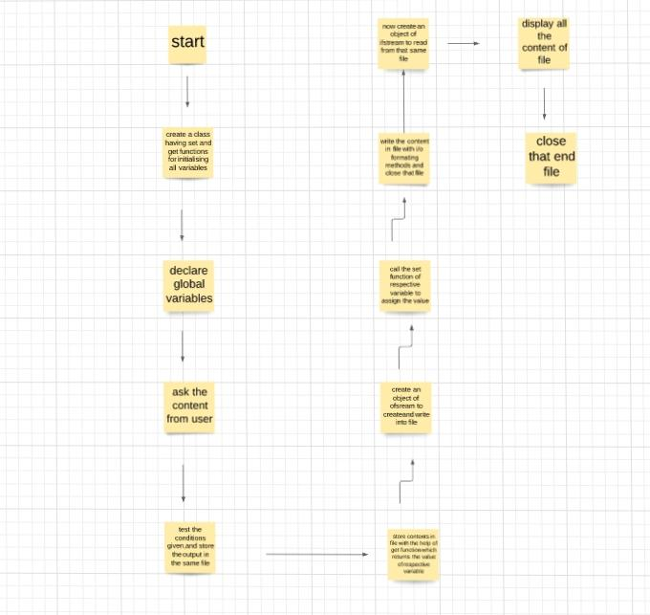
Flowchart

Slide 8
THANKS

